Slide 1



7th SYMPOSIUM ON CIRCULAR ECONOMY AND URBAN MINING
CAPRI, ITALY / 15-16-17 MAY 2024
TERRITORIAL RESOURCE EFFICIENCY IN CIRCULAR ECONOMY
PhD Jelena J. Stanković
PhD Ivana Marjanović

Slide 2

INTRODUCTION
To ensure environmental sustainability, it is imperative to reduce the consumption of renewable resources, identify suitable substitutes for non-renewable resources, and minimize the generation of waste and pollution.
The concept of a circular economy emerges as a viable and commendable response to enhance system sustainability.
The linear "take-make-dispose" model of resource consumption has proven unsustainable, leading to resource depletion, ecosystem degradation, and increasing waste generation.
In contrast, the circular economy offers a transformative approach that emphasizes the regenerative use of resources, minimizing waste and maximizing resource efficiency
The aim of the study: evaluation of circular economy efficiency across European Union nations using Data Envelopment Analysis (DEA).
Through the application of this methodology to country-level data, the paper attempts to generate a composite indicator of circular economy development, facilitating benchmarking and cross-country comparisons

Slide 3
METHODOLOGY, DATA AND MODEL DEVELOPMENT
DEA stands as a widely employed method for evaluating the efficacy of decision-making units within intricate scenarios featuring multiple inputs and outputs (Sinuany-Stern, 2023).
Originally introduced in 1978 by Charnes, Cooper, and Rhodes (Charnes et al., 1978), DEA leverages linear programming techniques to measure the performance of decision-making units.
Efficiency is determined by computing the ratio of the weighted sum of outputs to the weighted sum of inputs
The research presented in this paper is underpinned by empirical data sourced from various aspects of the circular economy framework, which are drawn from official Eurostat databases

Slide 4
METHODOLOGY, DATA AND MODEL DEVELOPMENT

Slide 5
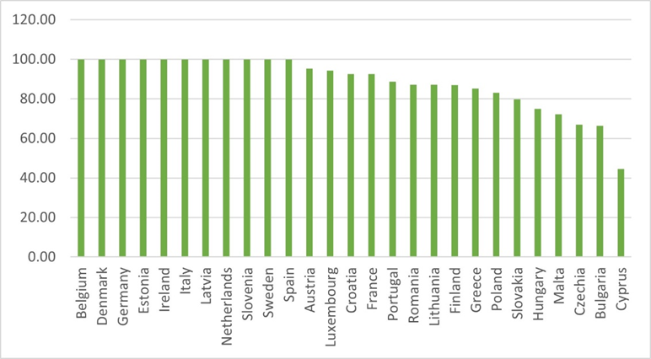
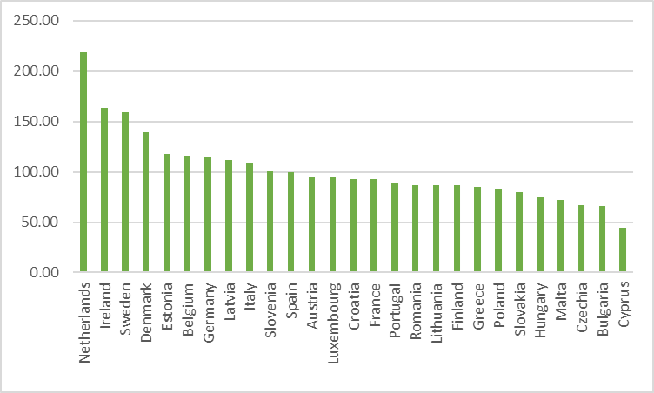
RESULTS AND DISCUSSION
Results of the efficiency analysis
Results of the Super-Efficiency analysis

Slide 6
CONCLUSIONS
The undeniable importance of the circular economy concept prompts the need to assess availability of suitable metrics for evaluating countries' advancements toward achieving circularity, bearing in mind that circular economy represents a multidimensional concept.
In recent times, an increasing number of nations have recognized the imperative to mitigate environmental degradation, with the transition to a circular economy emerging as a potential solution.
Nonetheless, the effective implementation of relevant policies is frequently hampered by the absence of metrics enabling comprehensive monitoring of progress toward circularity.
Therefore, evaluation of circular economy efficiency across European Union countries holds significant potential benefits for policymakers
The resulting ranking of European Union member states can serve as a valuable tool for identifying efficient countries and extracting lessons from their success to enhance the circular economy performance of less efficient nations.
By embracing this approach, decision-makers can gain insights into optimal resource utilization, facilitate strategic planning, and enhance overall performance

Slide 7
7th SYMPOSIUM ON CIRCULAR ECONOMY AND URBAN MINING
CAPRI, ITALY / 15-16-17 MAY 2024
TERRITORIAL RESOURCE EFFICIENCY IN CIRCULAR ECONOMY
PhD Jelena J. Stanković
PhD Ivana Marjanović
E-mail: ivana.veselinovic@eknfak.ni.ac.rs

